Slide 1
To Kill a Mockingbird – the Podcast
Using decomposition to explore characters and themes from the novel

Slide 2
Your Podcast
You and your team will be creating a podcast about To Kill a Mockingbird. Your podcast will be roughly five minutes long, and will include music, interviews, conversations and more.
What exactly fills the time of your podcast is up to you. You must choose options from our list, making sure that your total number of points is at least 50. These points will make up the effort half of your project grade; the remaining fifty points will be assigned based on the rubric at the end of this packet.

Slide 3
Podcast component options
5 points each
Commercial from a sponsor that relates to one of the themes or symbols from the novel
Intro music to start your podcast and exit music to end your podcast (5 points total)
Song snippet that is thematically relevant to the novel
10 points each
Interview with a character about a specific event in the novel
Interview with a character about another character in the novel
Conversation between two characters in the novel
15 points each
Interview with a character about a central theme from the novel
Interview with Harper Lee about a central theme from or her inspiration for the novel
News story about a related real-world historical event
Poem or rap about a central theme or major event in the novel
If you have another idea, you must ask if it is acceptable and how many points it is worth.

Slide 4
Creating your podcast
You will work with your team to first create an outline of your podcast.
Once your outline is approved, you will write out a complete script and rehearse it, seeing how long your podcast will be as planned.
Once your script is approved, you may begin recording and editing your podcast.
You cannot start recording or editing until your script is approved.

Slide 5
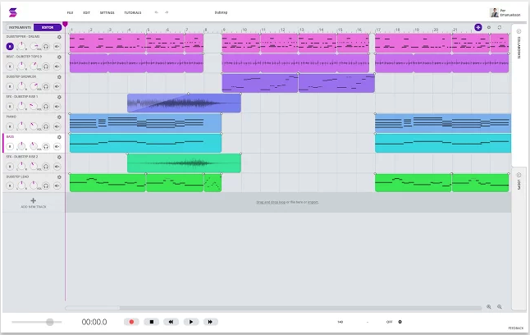
Soundtrap

Slide 7
 | Doesn’t Meet Expectations [0] |  | Approaching Expectations [1-4] |  | Meets Expectations [5-8] |  | Exceeds Expectations [9-10]
Outline | Outline not completed |  | Outline shows little planning effort Few details included Outline is messy and has many spelling and grammar errors |  | Outline shows some planning effort Some details included Outline is a little messy and has some spelling and grammar errors |  | Outline shows significant planning effort Many details included Outline is neat and polished and has very few spelling and grammar errors
Script | Script not completed |  | Script is incomplete Dialogue is not written in complete sentences Script has many spelling and grammar errors |  | Script is mostly complete Dialogue is mostly written in complete sentences Script has few spelling and grammar errors |  | Script is complete and professional Dialogue is written in complete sentences Script has very few or no spelling and grammar errors
Podcast: Content | Content does not follow any of the guidelines Connections to the novel are non-existent Content is boring |  | Content follows some of the guidelines Connections to the novel are weak Content is sometimes interesting |  | Content follows most of the guidelines Connections to the novel are strong Content is consistently interesting |  | Content follows all of the guidelines Connections to the novel are rich and very strong Content is creative and captivating
Podcast: Professionalism | Speech is impossible to understand Volume levels are all over the place Speakers sound like they do not take their roles seriously |  | Speech is hard to understand at times Volume levels fluctuate significantly Speakers sometimes do not take their roles seriously |  | Speech is occasionally hard to understand Volume levels fluctuate at times Speakers usually take their roles seriously |  | Speech is clear and understandable throughout Volume levels are well-balanced throughout entire podcast Speakers consistently take their roles seriously
Teamwork | No evidence of collaboration All team members fought or ignored one another One person seemed to make all of the decisions without consulting teammates |  | Little evidence of collaboration Two team members fought or ignored each other One person seemed to make most of the decisions without consulting teammates |  | Some evidence of collaboration Team functioned reasonably well to split work Team shared decision-making for most decisions |  | Strong evidence of great collaboration Team members showed great leadership and cooperation in sharing work and decision-making

