Slide 1
LIVE
BREAKING NEWS
US PRESIDENT CALLS ON STUDENTS TO HELP OUT
The death toll is rising, scientists now estimate that these earthquakes will affect as many as one hundred and twenty million American citizens across the country. Sixty-three other countries have experienced devastating earthquakes in the past two weeks as well, including Canada, France, Spain, China and India. Experts are at a loss as to what is causing this rash of destruction and are desperate for ideas on how to stop the madness. Fortunately, a team of middle school students have volunteered their efforts to help officials understand what is causing these earthquakes and if anywhere on Earth is safe. Keep it here on CT News for more. The death toll is rising, scientists now estimate that these earthquakes will affect as many as one hundred and twenty million American citizens across the country. Sixty-three other countries have experienced devastating earthquakes in the past two weeks as well, including Canada, France, Spain, China and India. Experts are at a loss as to what is causing this rash of destruction and are desperate for ideas on how to stop the madness. Fortunately, a team of middle school students have volunteered their efforts to help officials understand what is causing these earthquakes and if anywhere on Earth is safe. Keep it here on CT News for more. The death toll is rising, scientists now estimate that these earthquakes will affect as many as one hundred and twenty million American citizens across the country. Sixty-three other countries have experienced devastating earthquakes in the past two weeks as well, including Canada, France, Spain, China and India. Experts are at a loss as to what is causing this rash of destruction and are desperate for ideas on how to stop the madness. Fortunately, a team of middle school students have volunteered their efforts to help officials understand what is causing these earthquakes and if anywhere on Earth is safe. Keep it here on CT News for more. The death toll is rising, scientists now estimate that these earthquakes will affect as many as one hundred and twenty million American citizens across the country. Sixty-three other countries have experienced devastating earthquakes in the past two weeks as well, including Canada, France, Spain, China and India. Experts are at a loss as to what is causing this rash of destruction and are desperate for ideas on how to stop the madness. Fortunately, a team of middle school students have volunteered their efforts to help officials understand what is causing these earthquakes and if anywhere on Earth is safe. Keep it here on CT News for more. The death toll is rising, scientists now estimate that these earthquakes will affect as many as one hundred and twenty million American citizens across the country. Sixty-three other countries have experienced devastating earthquakes in the past two weeks as well, including Canada, France, Spain, China and India. Experts are at a loss as to what is causing this rash of destruction and are desperate for ideas on how to stop the madness. Fortunately, a team of middle school students have volunteered their efforts to help officials understand what is causing these earthquakes and if anywhere on Earth is safe. Keep it here on CT News for more. The death toll is rising, scientists now estimate that these earthquakes will affect as many as one hundred and twenty million American citizens across the country. Sixty-three other countries have experienced devastating earthquakes in the past two weeks as well, including Canada, France, Spain, China and India. Experts are at a loss as to what is causing this rash of destruction and are desperate for ideas on how to stop the madness. Fortunately, a team of middle school students have volunteered their efforts to help officials understand what is causing these earthquakes and if anywhere on Earth is safe. Keep it here on CT News for more.
to help officials understand what is causing these earthquakes and if anywhere on Earth is safe. Keep it here on CT News for more.
Notes:
It’s important to hype this activity up as important! If your students are like mine, they’ll fall into three groups:
Those who completely buy that this is real
Those who aren’t sure, and keep asking / making a skeptical face
Those who think it’s obvious this is fake, but appreciate your commitment to claiming it’s real
Make it as “real” as you want, but it’s fun to keep up the charade as long as possible.

Slide 2
What do we need to find out?
Where are these earthquakes happening?
Why are these earthquakes happening?
Can we predict where they will happen next? How?

Slide 3
How are we going to do this?
You’re going to come up with a prediction on why these earthquakes are happening and whether we can predict where they’ll strike next
You’re going to use real data and your pattern recognition skills to investigate and explain the ongoing earthquakes
You’re going to write a letter to the President

Slide 4
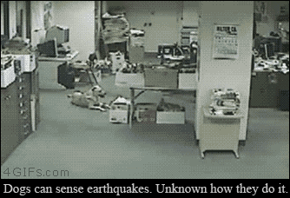
Turn and Talk
Why do earthquakes happen?
Can we predict where earthquakes will happen? How?
Notes:
This slide really depends on how far into your earthquake and tectonic plate unit your students are. If they already know about the connection between the two, that’s great – this is good review. If this activity will be the first time they discover it, that’s great too!
The (real) video shows a dog reacting to an earthquake long before humans do. Check out http://gizmodo.com/5833733/how-your-dog-knows-an-earthquake-is-coming-way-before-you-do for more information on how dogs are so tuned in.

Slide 5
Mapping recent earthquakes
The Incorporated Research Institution for Seismology provides data about earthquakes within the last month at http://ds.iris.edu/sm2/eventlist/
You will choose earthquakes from that list and plot them on a world map using the earthquake’s GPS coordinates
Plot earthquakes on your map with a large dot: ●

Slide 6
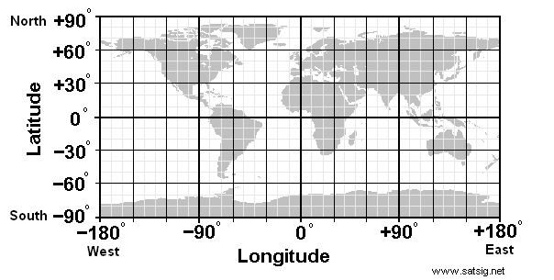
Using GPS coordinates
GPS coordinates are similar to ordered pairs
Instead of (x, y) you use (latitude, longitude)
Note that latitude is the y-axis and longitude is the x-axis
Notes:
Some students struggle with GPS coordinates. This will work best if students have already learned about the Cartesian coordinate plane and plotting coordinate pairs – make those connections strong for your students! They’ll likely need frequent reminders that GPS coordinates go (y,x) instead of (x,y), based on their understanding of the directions of x and y.

Slide 7
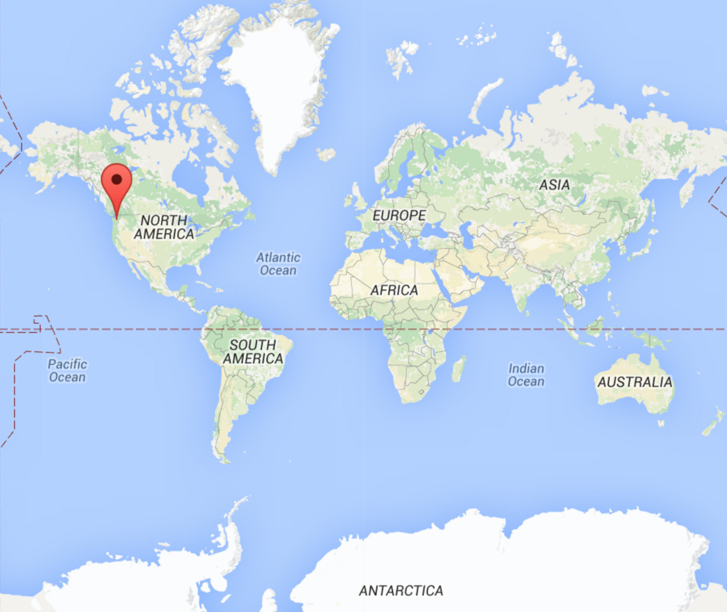
Using GPS coordinates
Seattle's coordinates are:
Latitude: 47.61
Longitude: -122.33
GPS: (47.61, -122.33)
Notes:
Feel free to update this to your school’s location!

Slide 8
Practice on the board!
Notes:
Have individual students come up to the board and plot GPS coordinates you read out or write on the board. Ask the rest of the class if they are correct after each.

Slide 9
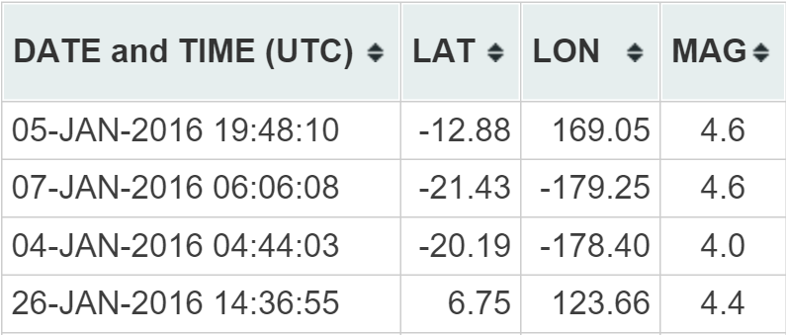
ds.iris.edu/sm2/eventlist/
Positive latitude is north Lat: -12.88
Negative latitude is south Long: 169.05
Positive longitude is east (-12.88, 169.05)
Negative longitude is west
Notes:
At this slide, students jump into data collection and plotting. Leave this slide up as students work.

Slide 10
We need some more earthquakes!
You all have done a great job plotting earthquakes using latitude and longitude – now let’s use a live map
www.iris.washington.edu/ieb/
Notes:
After 15-20min, students should ideally have about 20 earthquakes plotted on their maps. Praise their success so far, but it’s unlikely they’re noticing strong patterns yet. Tell them we’re going to speed things up by using visual map data instead of just GPS coordinates to better understand the patterns we are maybe starting to see. Students should be quickly plotting dozens of earthquakes with this new link.

Slide 11
What have we learned so far?
Do earthquake locations seem random, or is there a pattern to where they are located?
If there is a pattern, do you think future earthquakes are likely to follow that pattern?
Come up with at least three high-risk areas to include in your report to the President
Notes:
After another 5-10min, regroup the class and lead a discussion on what they’re seeing.

Slide 12
Are plate boundaries involved?
Compare your earthquake map to the tectonic plate map
What do you think the correlation is?
What do you think is happening where two plates are touching each other?
Where are the danger zones?
Notes:
Pass out the tectonic plate boundary transparencies. Have students line them up with their maps and make observations about their patterns.

Slide 13
It’s time to write to the President so he can author a bill to save the world!
Notes:
Students will now write their letters, explaining their understanding with scientific backing.

Slide 14
Your letter should include:
Your initial predictions and if/how they have changed
Where recent earthquakes are happening and where you think they will happen next
Why these earthquakes are happening and if there is any way to prevent them
Anything else you have learned during this investigation

Slide 15
You’ve saved the world!
…for now

