Slide 1
Designing a Greek Monument
In 3D!

Slide 2
Ancient Greek Monuments
Often dedicated to one of the Greek gods, sometimes to battles
Pillars. Pillars everywhere.
Unlike some modern monuments, these buildings all had functions – they were used by Greek citizens for a purpose, not just as a remembrance

Slide 3
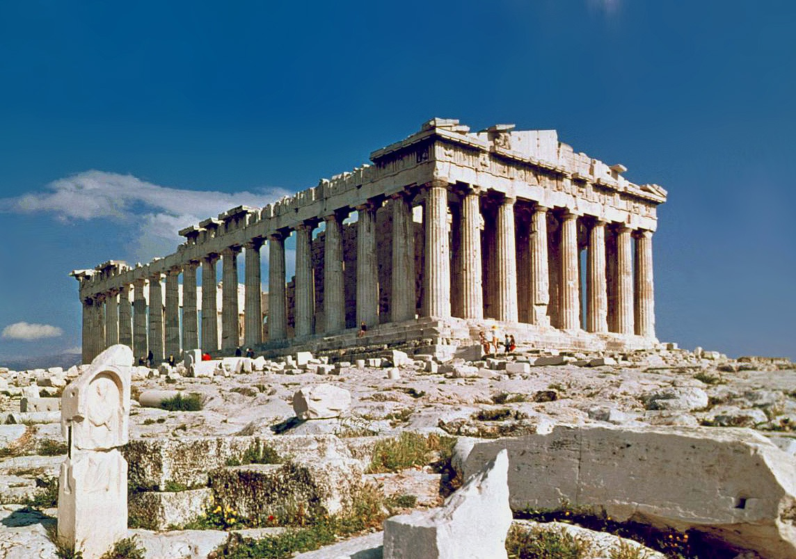
Parthenon
Functioned as a temple
Dedicated to Athena
Built 438 BC

Slide 4
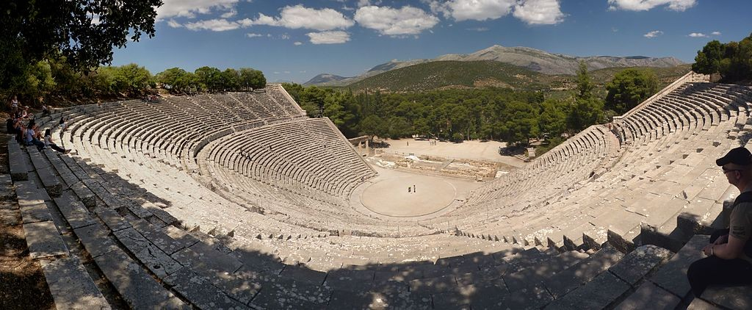
Epidaurus Theater
Functioned as a theater
Dedicated to Asklepios, god of healing
Built 325 BC

Slide 5
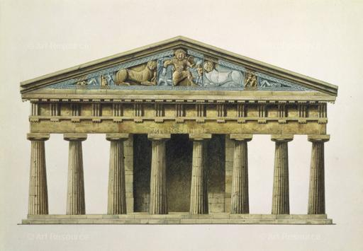
Temple of Artemis
Functioned as a temple
Dedicated to Artemis
Built 580 BC

Slide 6
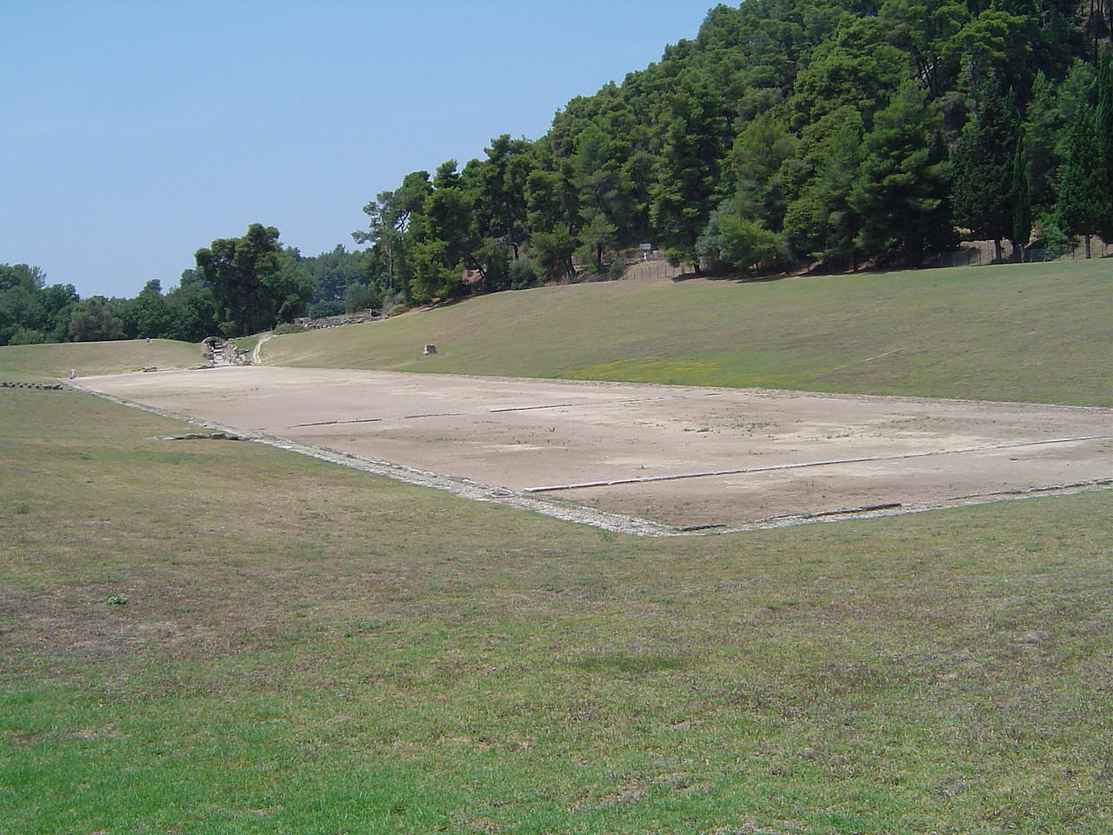
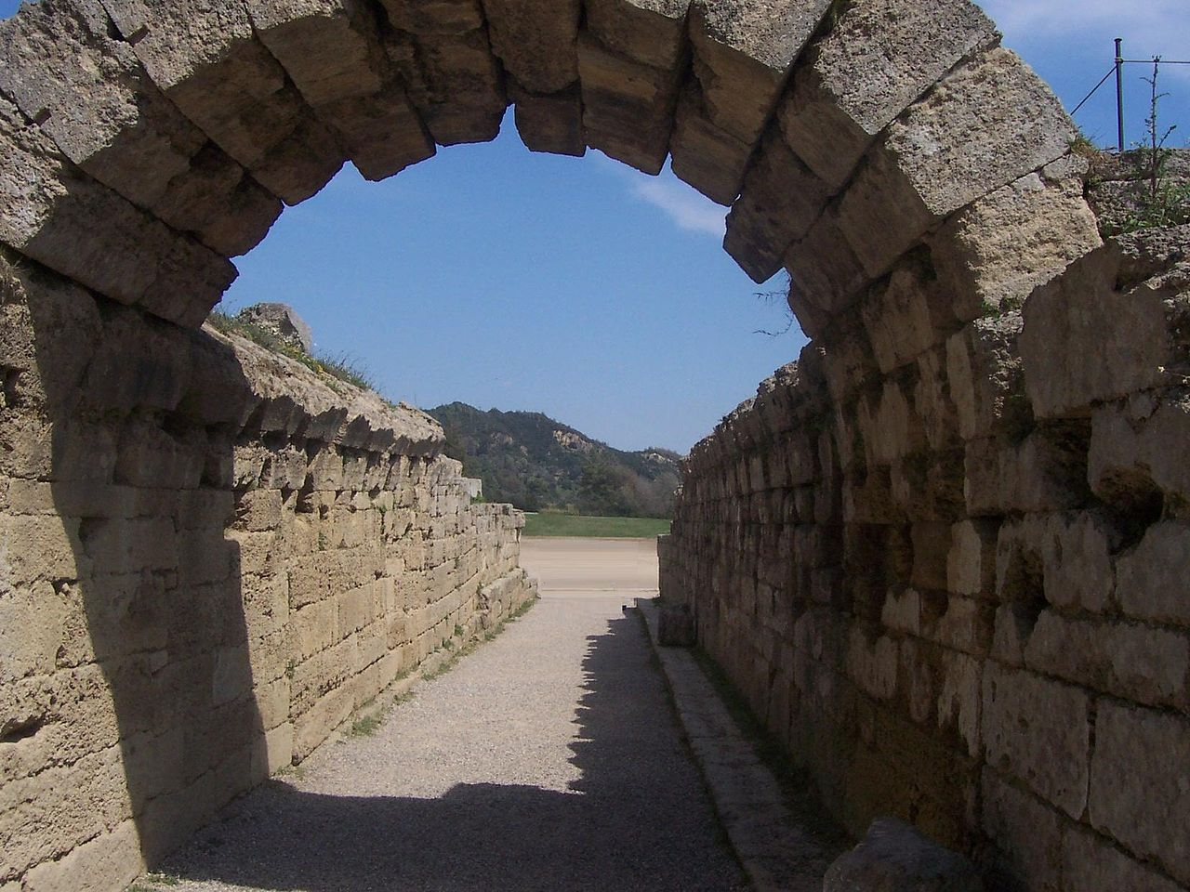
Stadium at Olympia
Original site of Olympic games
Dedicated to Zeus, as were the games
Built 560 BC

Slide 7
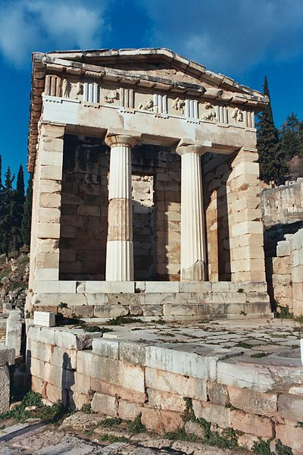
Treasury of Athens
Functioned as a treasury
Dedicated to winning the Battle of Marathon
Built 480 BC

Slide 8
2500 years later… it’s your turn!
Choose an event, a god/goddess or some other aspect of Ancient Greece
Sketch a monument design dedicated to whatever you chose – use abstraction to think about how your architecture relates to your topic!
Create your monument in 3D using TinkerCad
Write two paragraphs to accompany your design describing how you came up with the idea and how your monument relates to your topic

Slide 9
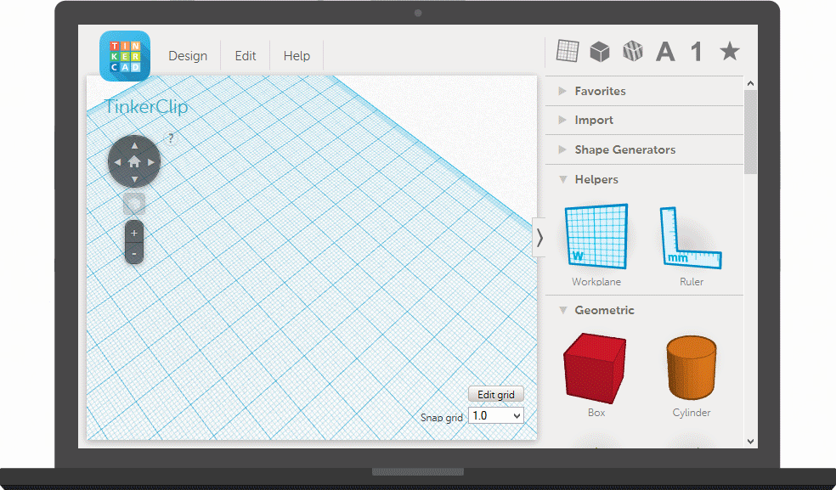
TinkerCad

Slide 10
Grading rubric
 | Doesn’t meet expectations [0] | Approaching expectations [1-4] | Meets expectations [5-8] | Exceeds expectations [9-10]
Sketch | Sketch not completed | Sketch is not understandable Sketch doesn’t relate to 3D model | Sketch is understandable Sketch was used while creating 3D model | Sketch is clear and well thought out Sketch closely aligns with 3D model
3D monument | 3D monument not completed | 3D monument uses fewer than five elements 3D monument does not reflect Ancient Greek style | 3D monument uses between five and ten elements 3D monument could be seen as using Ancient Greek style | 3D monument uses more than ten elements 3D monument is a clear reflection of Ancient Greek style
Written explanation | Written explanation not completed | Written explanation shorter than two full paragraphs Written explanation does not connect chosen topic with monument | Written explanation is at least two paragraphs Written explanation makes some attempt to connect chosen topic with monument | Written explanation is at least two well-structured paragraphs Written explanation clearly connects chosen topic with monument
Creativity and effort | Total lack of creativity or effort | Some creativity is seen across all elements Some components show signs of effort | Creativity is seen across all elements All elements show signs of effort | All elements are exceptionally creative and clearly took a great deal of effort

Slide 11
Go to: tinkercad.com

Slide 12
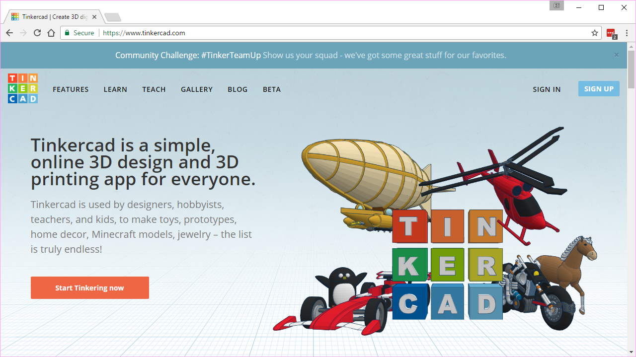

Slide 13
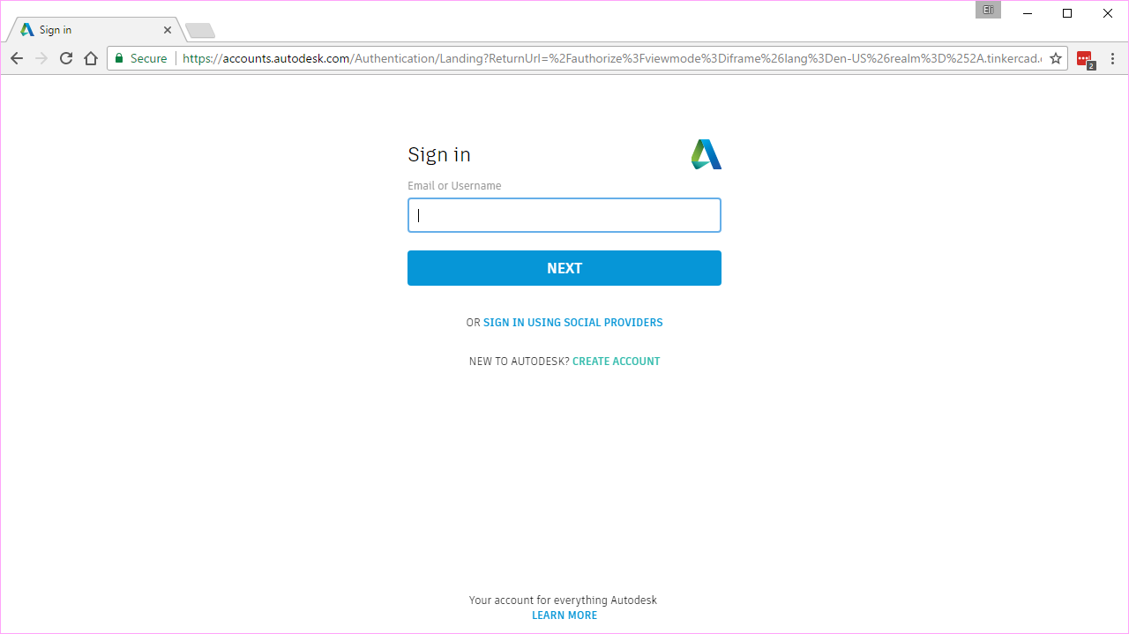

Slide 14
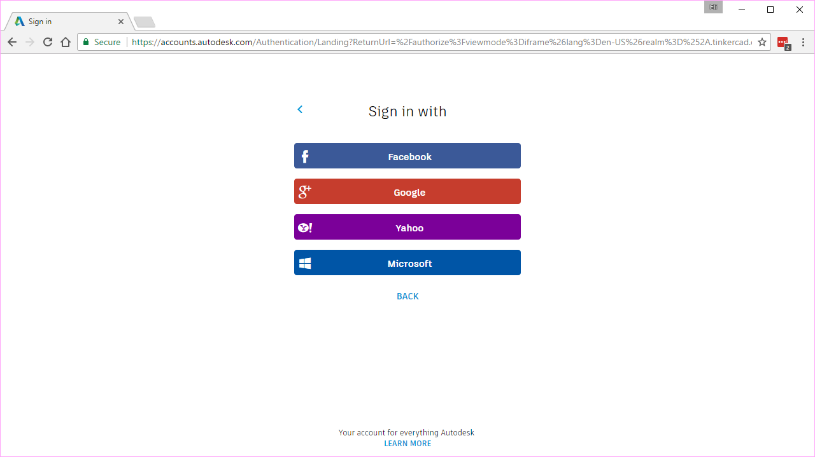

Slide 15
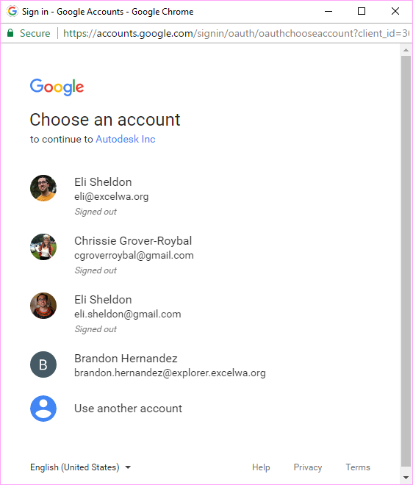

Slide 16
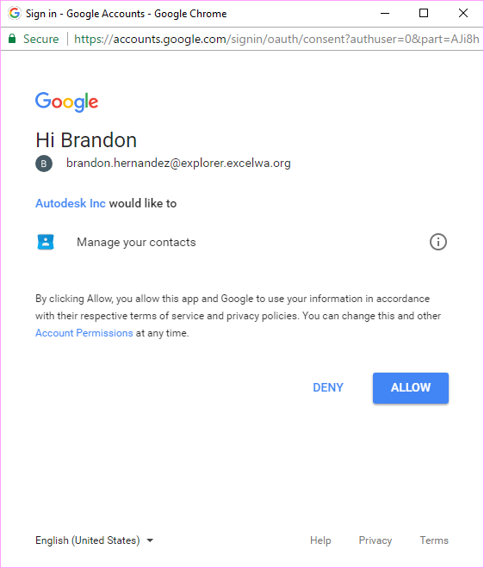

Slide 17
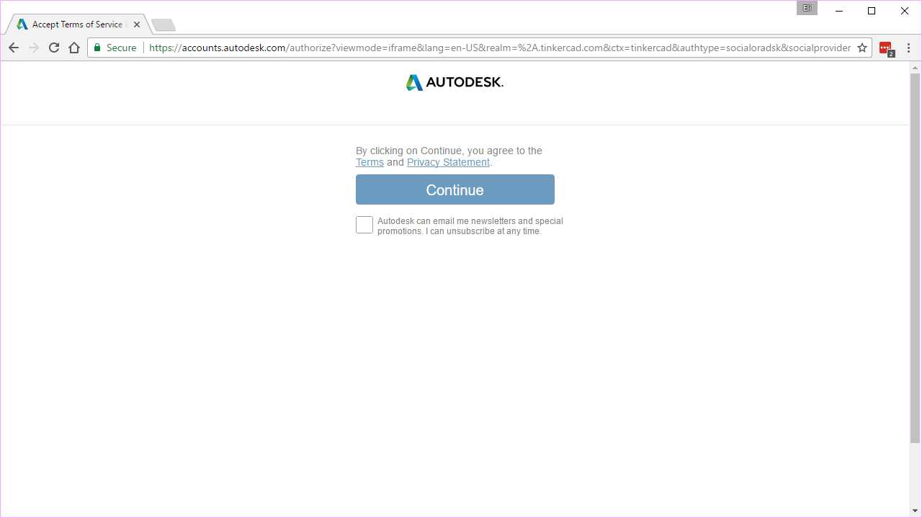

Slide 18
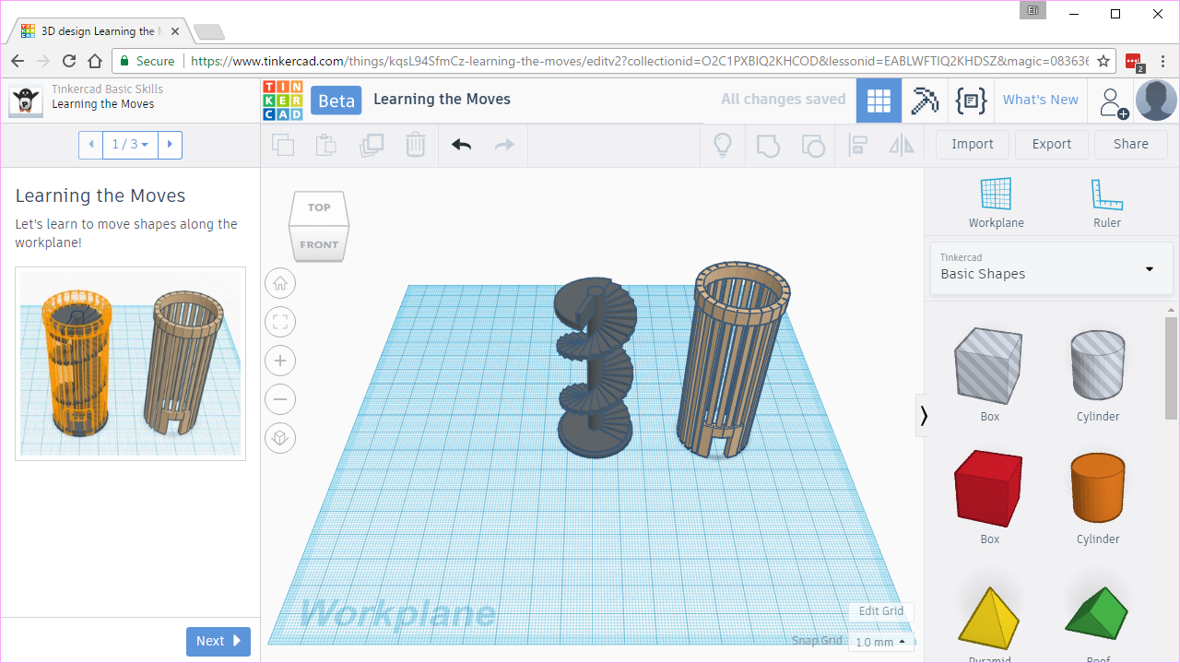

Slide 19
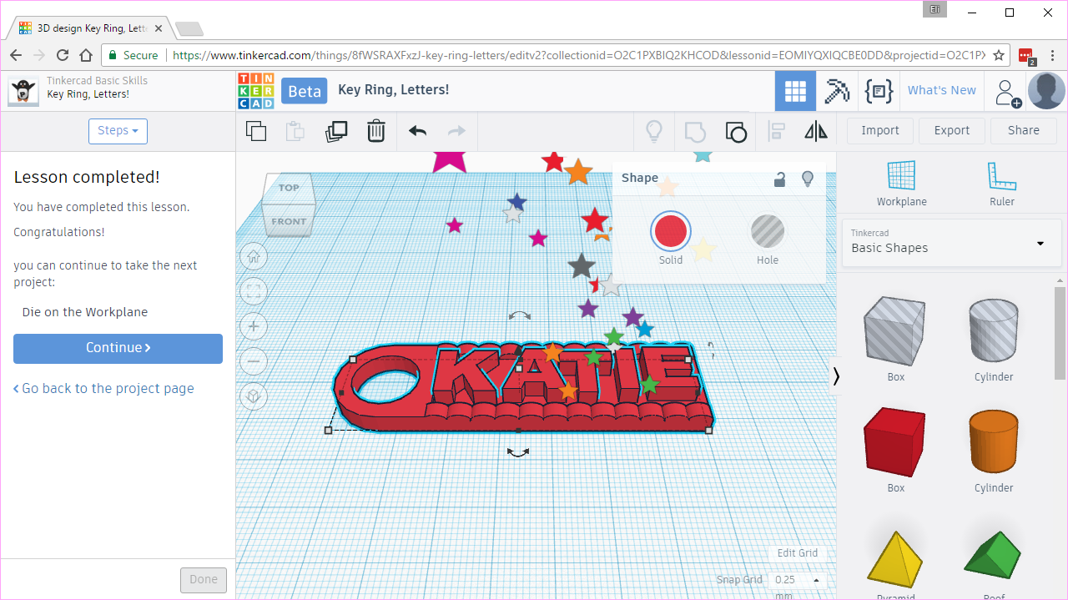
Complete the first five lessons, stopping when you complete the Key Ring

Slide 20
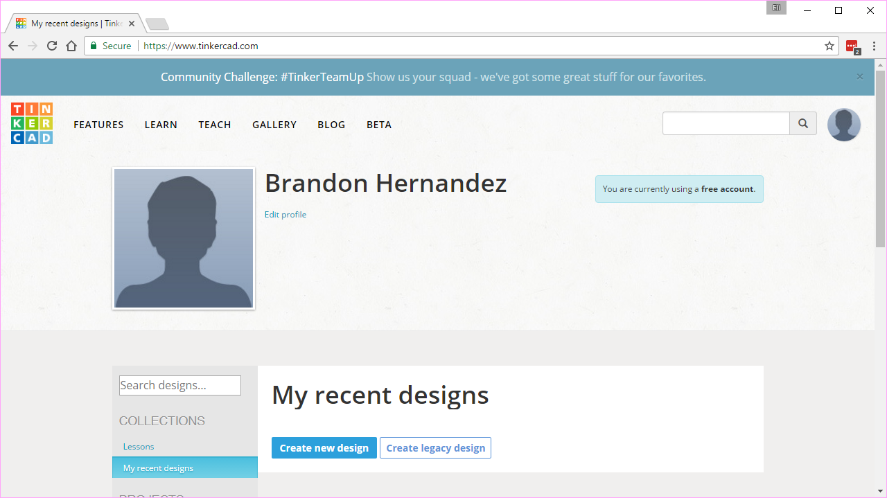

Slide 21
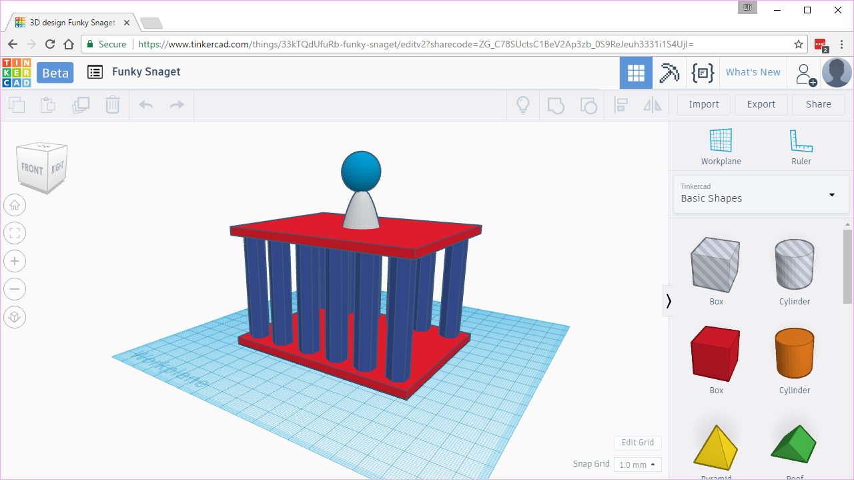
When you are done, make sure you paste the Share link into your Google Doc

Slide 22
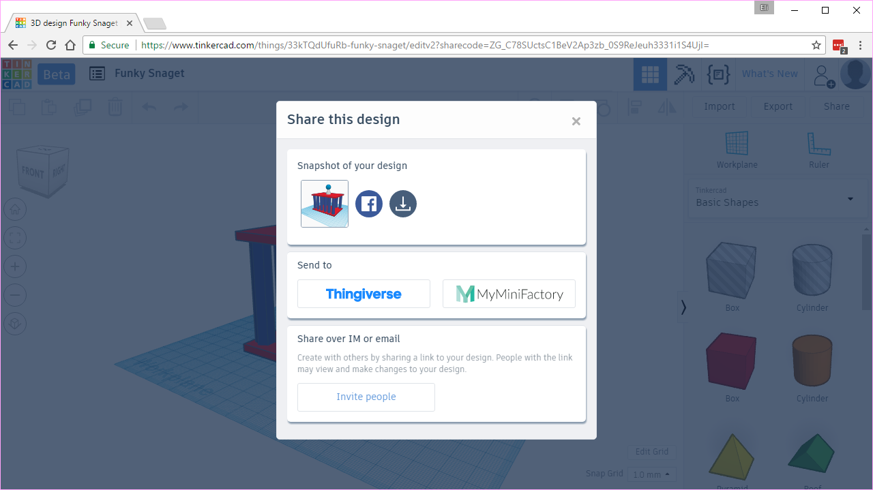

Slide 23
