Slide 1
Body System Amusement Parks
It’s like your favorite water park, but with blood!

Slide 2
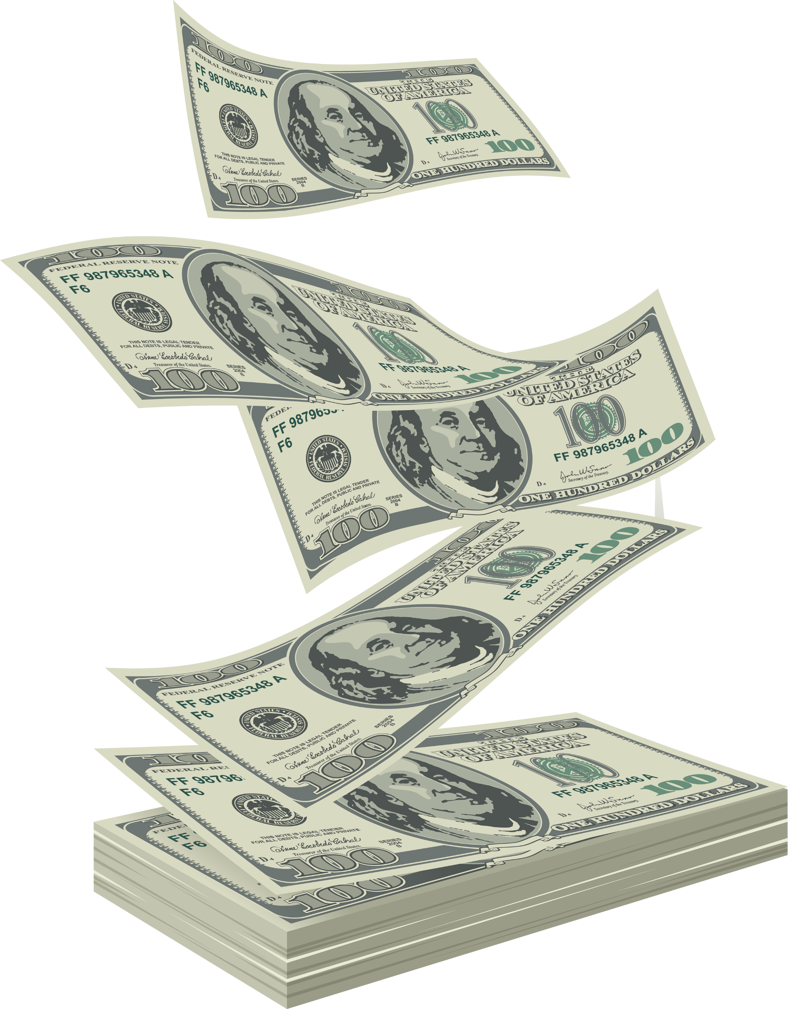
Who we are and what we want
A local, highly wealthy investment firm specializing in unique amusement parks is looking to you for help
They are now accepting proposals for a new $150 million amusement park in your town based on the human body
Your team will create a 3D scale model of your proposed amusement park, as well as a presentation explaining each attraction within the park

Slide 3
Your scale model must include:
At least five total attractions (rides, concession stands, games, etc) representing at least five of these body systems:
Circulatory system
Respiratory system
Nervous system
Digestive system
Muscular system
Skeletal system
Park entrance, a ticket booth, walkways, and signs for each attraction
Optional: trees and bushes, fountains, parking lot, other elements commonly found in amusement parks

Slide 4
Your presentation must include:
A name for each attraction, as well as a description (at least three sentences) that describes how it relates to the body system and body parts (organs, muscles, bones, etc) it is based on
The name of your amusement park
What makes your amusement park better than the other proposals – why should we fund your idea?

Slide 5
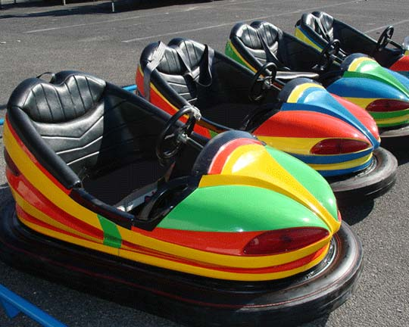
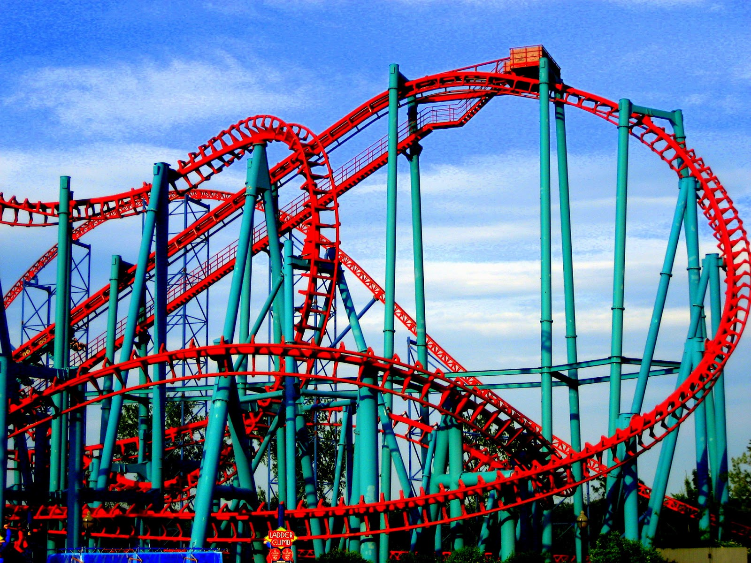
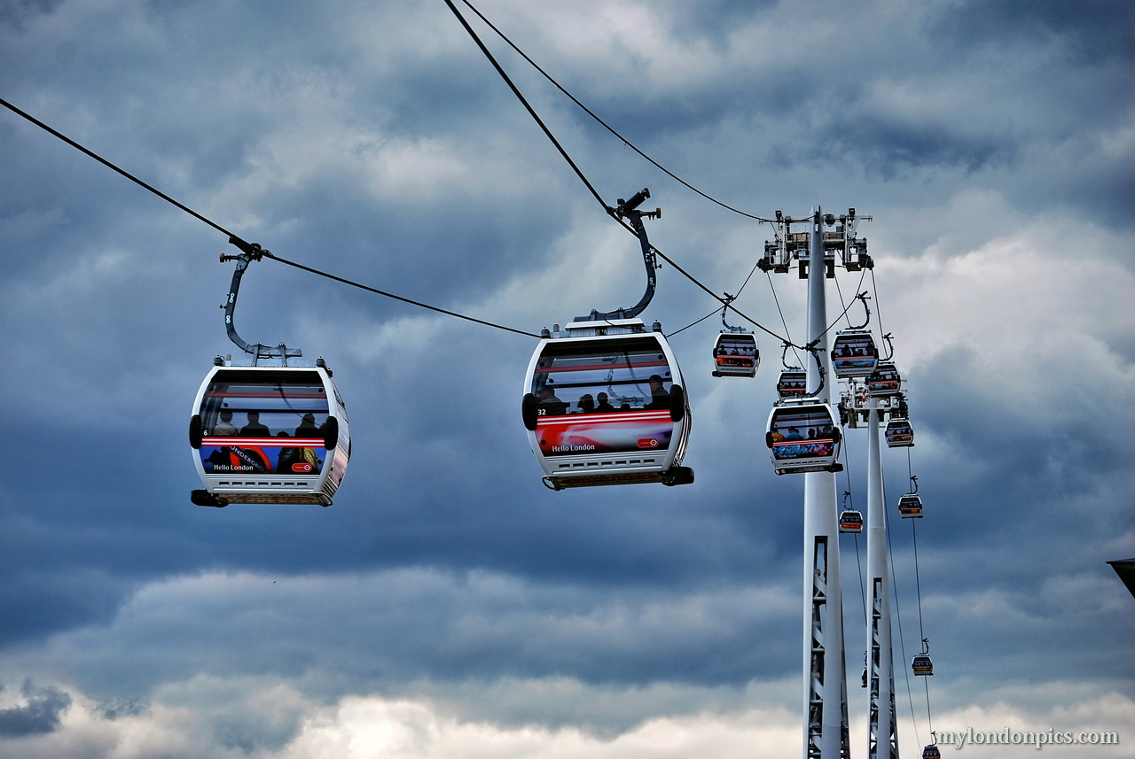
Attraction Ideas
Roller coaster
Carousel
Bumper cars
Ferris Wheel
Water slide
Funhouse
Cable cars
Hot Shot
Whac-a-Mole

Slide 6
Grading rubric
 | Developing (5 pt) | Proficient (8pt) | Advanced (10pt)
Scale model execution | Fewer than five attractions Missing some park elements | At least five attractions All required park elements | More than five attractions All required park elements At least two optional elements
PowerPoint execution | Missing names or descriptions Descriptions are too short Poor design Argument for being the best is unpersuasive | Names and descriptions for each attraction Good design Decent persuasive argument for being the best | Names and descriptions for each attraction Professional design Excellent persuasive argument for being the best
Scientific relevance and accuracy | Little connection to body parts and systems Does not demonstrate understanding of all five body systems | Good connections to body parts and systems Demonstrates understanding of all five body systems | Strong connections to body parts and systems Demonstrates deep understanding of all five body systems
Creativity | Attractions all seem similar Names are not related to the attractions | Each attraction is distinct Names are relevant to the attraction | Each attraction is distinct and seems like fun Names are relevant and humorous

Slide 7
Instructions (within your teams)
Discuss amusement parks you’ve been to, and different types of attractions you’ve seen
For each body system, brainstorm a few attraction ideas that could go in your amusement park. Attractions can represent one or more component within that system.
Decide which attractions you want in your amusement park based on available materials and creating a variety of attractions
Begin building your amusement park! Don’t forget to save enough time to create a professional presentation.

